Slide 1

Capstone Project: Basketball Analytics
Jack Blumstein

Slide 2
Information about Data
Data taken from: https://www.basketball-reference.com/
Currently looking at 480 rows with 25 columns
Using per-game statistics
Many teams have injured players that they pay the salary for, so the top three salaries will consider only those who played in games

Slide 3
Lit Review
Predicting if NBA Teams Will Make the Playoffs Based on Estimated Wins Added (EWA) and Salary - Most similar to what I want to do - This used salary of each player on the team and the advanced statistic estimated wins added - Data was taken from the 2016-17 and 2017-18 basketball seasons - Was able to predict if a team made the playoffs with a 73.3% accuracy

Slide 4
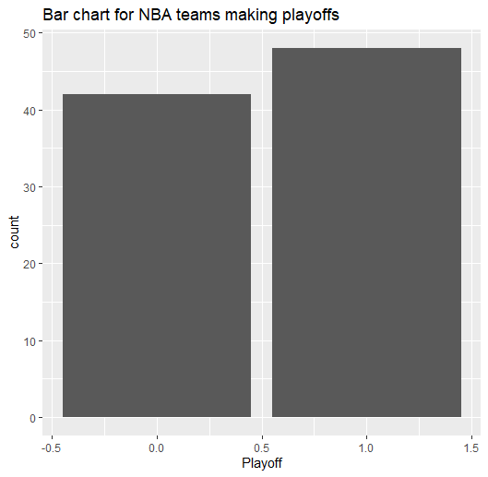
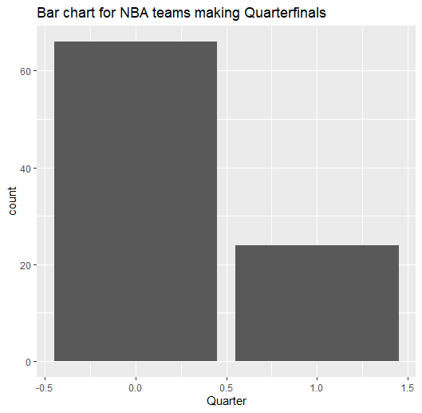
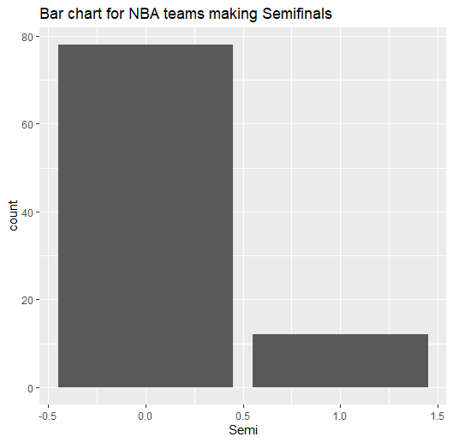
Analysis
Just looking at the data without doing any real analysis, you can tell that teams that make the playoffs tend to spend more on their top three players than teams that don’t make the playoffs

Slide 5
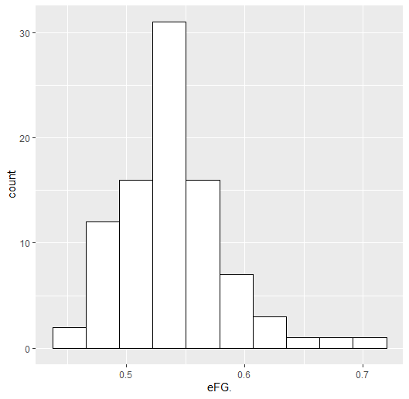
Histogram of Effective Field Goal Percentage
Median: 0.534
Mean: 0.5389
SD: 0.0442

Slide 6
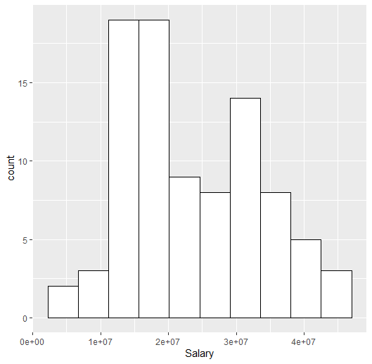
Histogram of Salaries
Median: 20478572
Mean: 23318862
SD: 9898067

Slide 7
What needs to be done next
Implement Models to find the relationship between Salary, PTS/G, eFG, AST, TRB, STL, BLK, TOV for the top 3 highest paid players per team and the team makes Playoffs
Get More data from previous years

